Slide 1
The Road to the Creative Lab & Media Studio
Kelli WooShue
Halifax Public Libraries
Notes:
In preparing for presentation, it’s been interesting to reflect on the process that led to the Central Library’s Creative Lab and Media Studio
Also glad that I seem to have held onto every piece of paper that the process generated.
Challenge to distill 1+ year’s activity into ~10 minutes
Hope that if you’re thinking of starting a makerspace – or even if you already have one up and running – you’ll find the information I’m going to share useful.

Slide 2
Agenda
Backstory
Planning the Creative Lab & Media Studio
Getting started
The Basics
Programming
Policies
Playing in the Sandbox: Program Development
Program Modules
Regional kits
For More Information

Slide 3
The backstory

Slide 4
Backstory
Part of planning team working on Central Library project (2013-2014)
Areas of responsibility included (not limited to)
Spaces
Creative Lab
Media Studio
Staffing
Programming
Opening day activities
Media Studio
Creative Lab

Slide 5
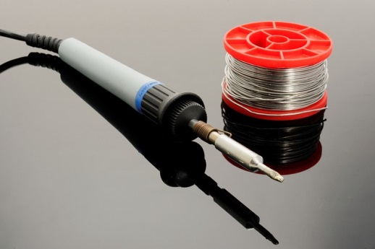
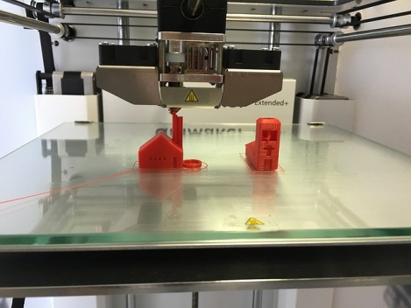
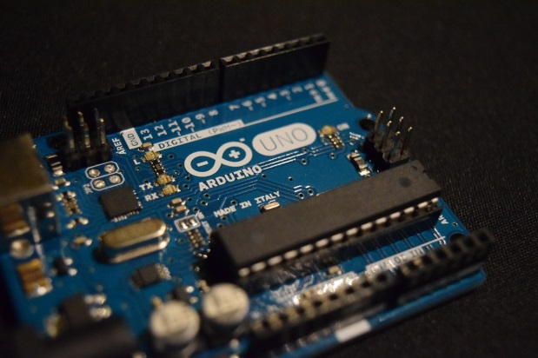
What’s in a name?
Why ‘Creative Lab’?
Makerspace’ carries a lot of baggage
Makerspace =
Notes:
Before we get too far, want to explain that I won’t be using the word ‘makerspace’ in my presentation
Even before we had the particulars figured out, we had a sense of what we wanted – higher level – for the spaces
Access/opportunity
Inclusion
impact
For a lot of people conjures ideas of
High tech
Exclusivity
High level technical ability
High level education

Slide 6
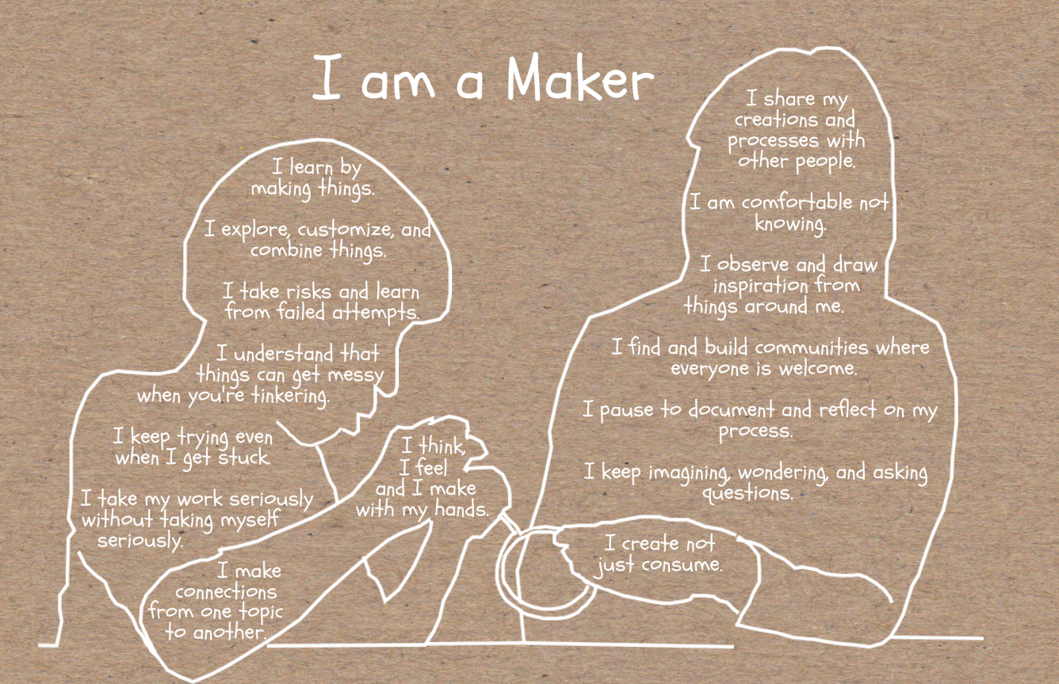
Making is
Creativiity
Curiosity
Exploration
Learrning
Connecting

Slide 7
Planning the creative lab & media studio

Slide 8
Getting Started
Didn’t need to reinvent the wheel
Lots of good information close at hand
Webinars
Articles/books
Websites
Blogs
Library-specific resources
Notes:
Corey Wittig, Carnegie Library, Pittsburgh, PA
Nick Taylor, Arapahoe Public Library (Colorado)
Ellyssa Kroski

Slide 9
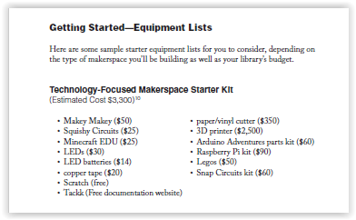
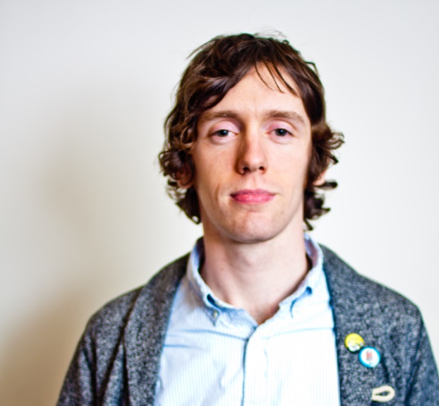
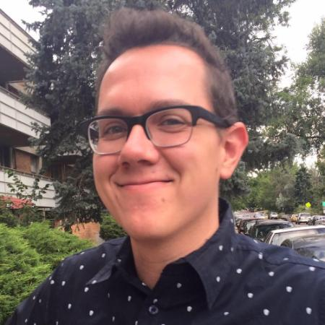
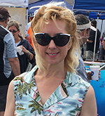
Library Technology Reports
The Makerspace Librarian’s Sourcebook
Corey Wittig / Nick Taylor / Ellyssa Kroski

Slide 10
Getting Started
Also
Peers
Music studio – HPL staff with recording experience/expertise
Site visits (e.g., NSCC, Centre for Arts & Technology)

Slide 11
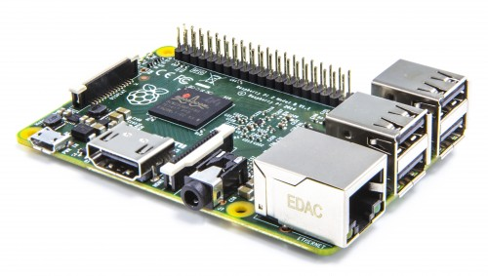
The Basics – The Creative Lab
3D printer
Arduino (Spark Fun Inventor’s Kits)
LEGO Mindstorm
MaKey MaKey
Little Bits
Raspberry Pi
Notes:
Raspberry Pi
“The Raspberry Pi is a credit-card-sized computer that plugs into your TV and a keyboard. It is a capable little computer which can be used in electronics projects, and for many of the things that your desktop PC does, like spreadsheets, word processing, browsing the internet, and playing games”
Youth Services – microwaves, button maker

Slide 12
The Basics – Media Studio
Work stations – iMacs
Audio interfaces
Microphones
Headphones
Studio monitors
Camera & camcorder
Green screen
Wacom tablet
Instruments
Misc. accessories (e.g., cables)

Slide 13
Programming
Open Create
Opportunity to see & try
Specific topics
Orientation sessions (get familiar with a specific piece of equipment/kit)
Project sessions
Single sessions
Multi-part (complete a project over a series of sessions)
Examples
Scratch
Design for 3D printing

Slide 14
Policies
3D printing equipment
Orientations to Media Studio
Youth

Slide 15
Playing in the sandbox

Slide 16
The Sandbox Series
Change of focus with creation of eServices department
Move from branch & regional → regional
Relocation to Central Library
November 2016 – develop programming to be piloted in Creative Lab

Slide 17
The Sandbox Series
Goals
Redefining ‘making’ for community
Demonstrating the making continuum
(s)low to high tech
All ages
In-house vs. guest presenters
Opportunity for partnership/collaboration

Slide 18
The Sandbox Series
Programs
Upcycling
ReFresh
Embroidery
Crafts & Circuits
Makerspace Go! (mobile makerspace)

Slide 19
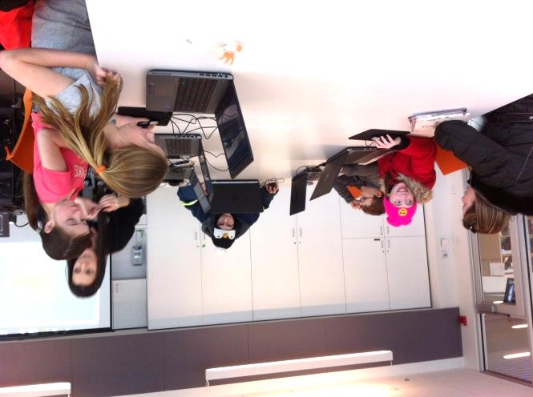
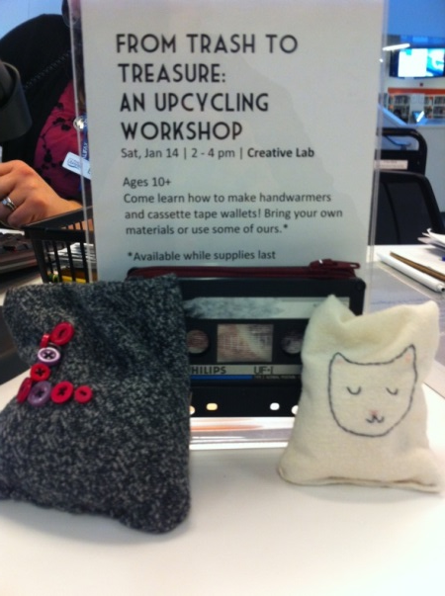
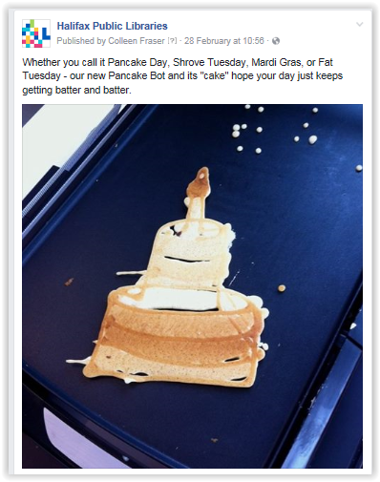
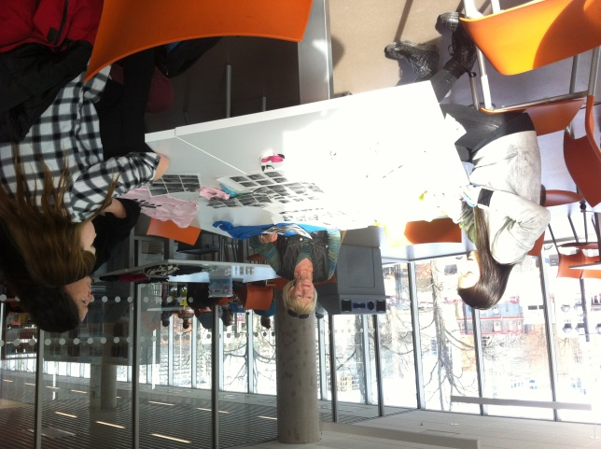

Slide 20
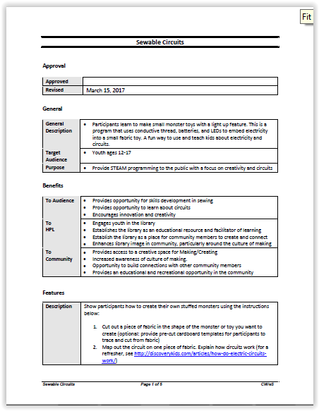
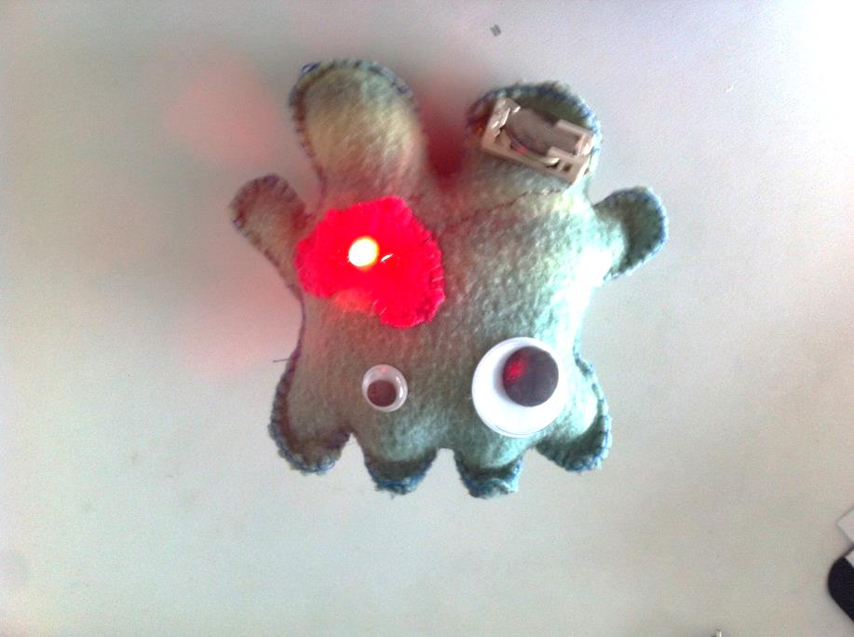
Program Modules
Examples:
Green screen photography using DoInk
Playing with Food Science
Sewable Circuits
Tech the Creative Lab
Notes:
Can be delivered at any branch
Can be delivered by staff with range of technical experience
Adaptable/customizable to community, audience, budget
→ Source of inspiration, not ‘must do’

Slide 21
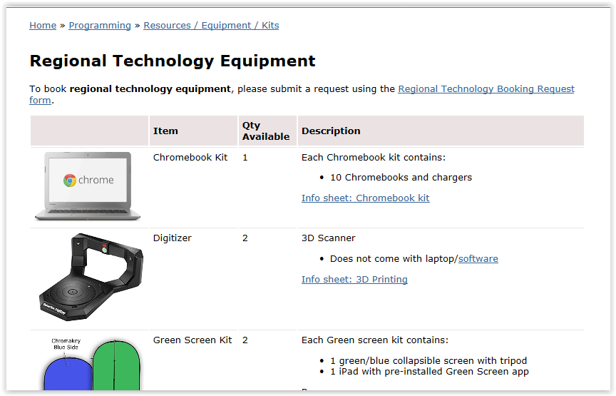
Regional Kits
Examples:
Green screen kit
PancakeBot
Regional iPad kits
Notes:
can be borrowed by any branch
Loans managed by eServices
Branches have access to a kit for ~1 week
eServices provides tech support (e.g., training for 3D printer, digitizer)

Slide 22
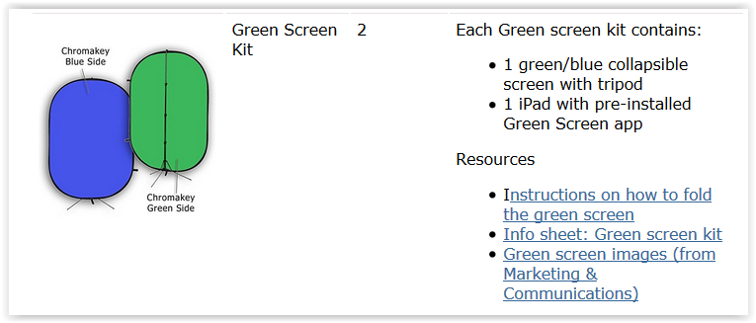
Regional Kits
Green screen kit
Notes:
Open PDFs

Slide 23
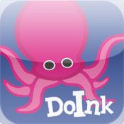
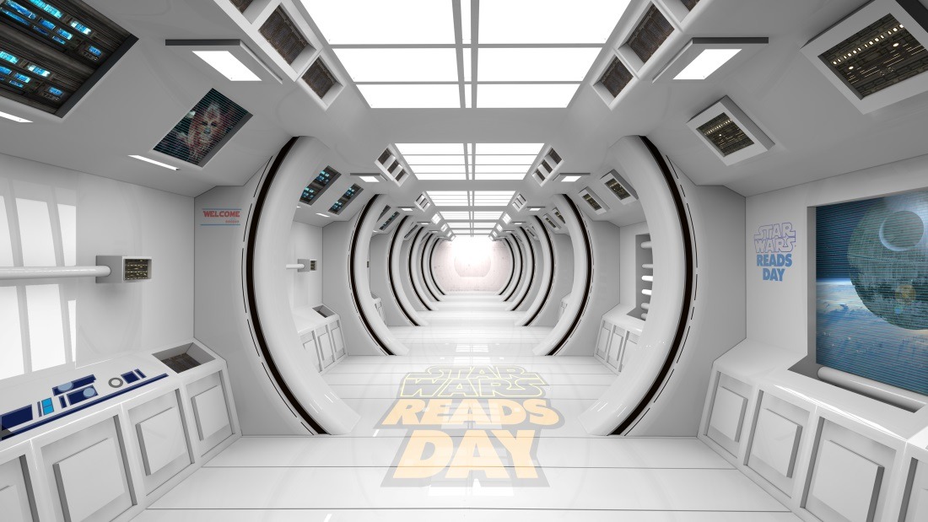
Regional kits

Slide 24
For more information

Slide 25
For More Info
Makerspaces.com https://www.makerspaces.com/
Librarian’s Guide to Makerspaces http://oedb.org/ilibrarian/a-librarians-guide-to-makerspaces/
Public Libraries Online – Makerspaces http://publiclibrariesonline.org/tag/makerspaces/

Slide 26
For More Info
Media Studio: http://www.halifaxpubliclibraries.ca/branches/locations/halifax-central-library.html
Media Studio - Inventory: http://www.halifaxpubliclibraries.ca/assets/files/central-library/Media_Studio_Inventory_rev2017Apr.pdf

Slide 27
Call Me Maybe
Kelli WooShue, eServices
wooshuk@halifax.ca
902-292-2984
Pinterest
Maker/Creative Spaces – Libraries https://www.pinterest.ca/kaywuu/makercreative-spaces-libraries/
Maker/Creative Spaces – Equipment https://www.pinterest.ca/kaywuu/makercreatives-spaces-equipment/
Storify https://storify.com/KelliW/making-in-the-library

Slide 28
Photo credits
Slide 6
http://www.goldcrownenrichment.org/maker-movement/
Slide 9:
Corey Wittig: http://www.libraryasincubatorproject.org/?p=6653
Nick Taylor: https://www.linkedin.com/in/nick-taylor-53ab054a/
Ellysa Kroski: https://www.linkedin.com/in/ellyssa/

