Slide 1
Borrow by Mail
roundtable discussion
NSLA/LBANS Conference
September 29, 2017

Slide 2
Borrow by Mail at
Halifax Public Libraries
started in 1983
department based at Alderney Gate Public Library in Dartmouth
2 full time staff, 2 part time staff
send out 6 Updates a year
select for about 22% of clients
Borrow by Mail clients are “fine-free”

Slide 3
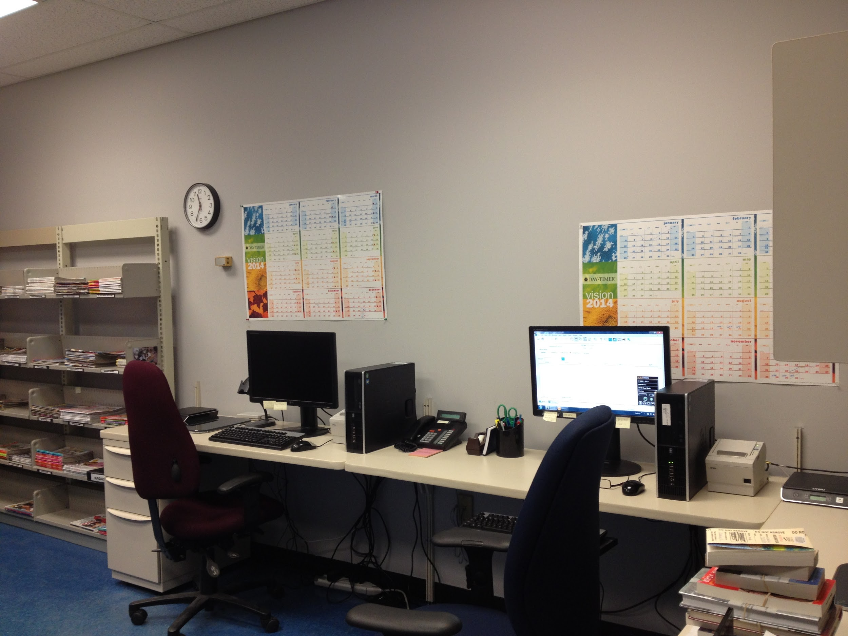
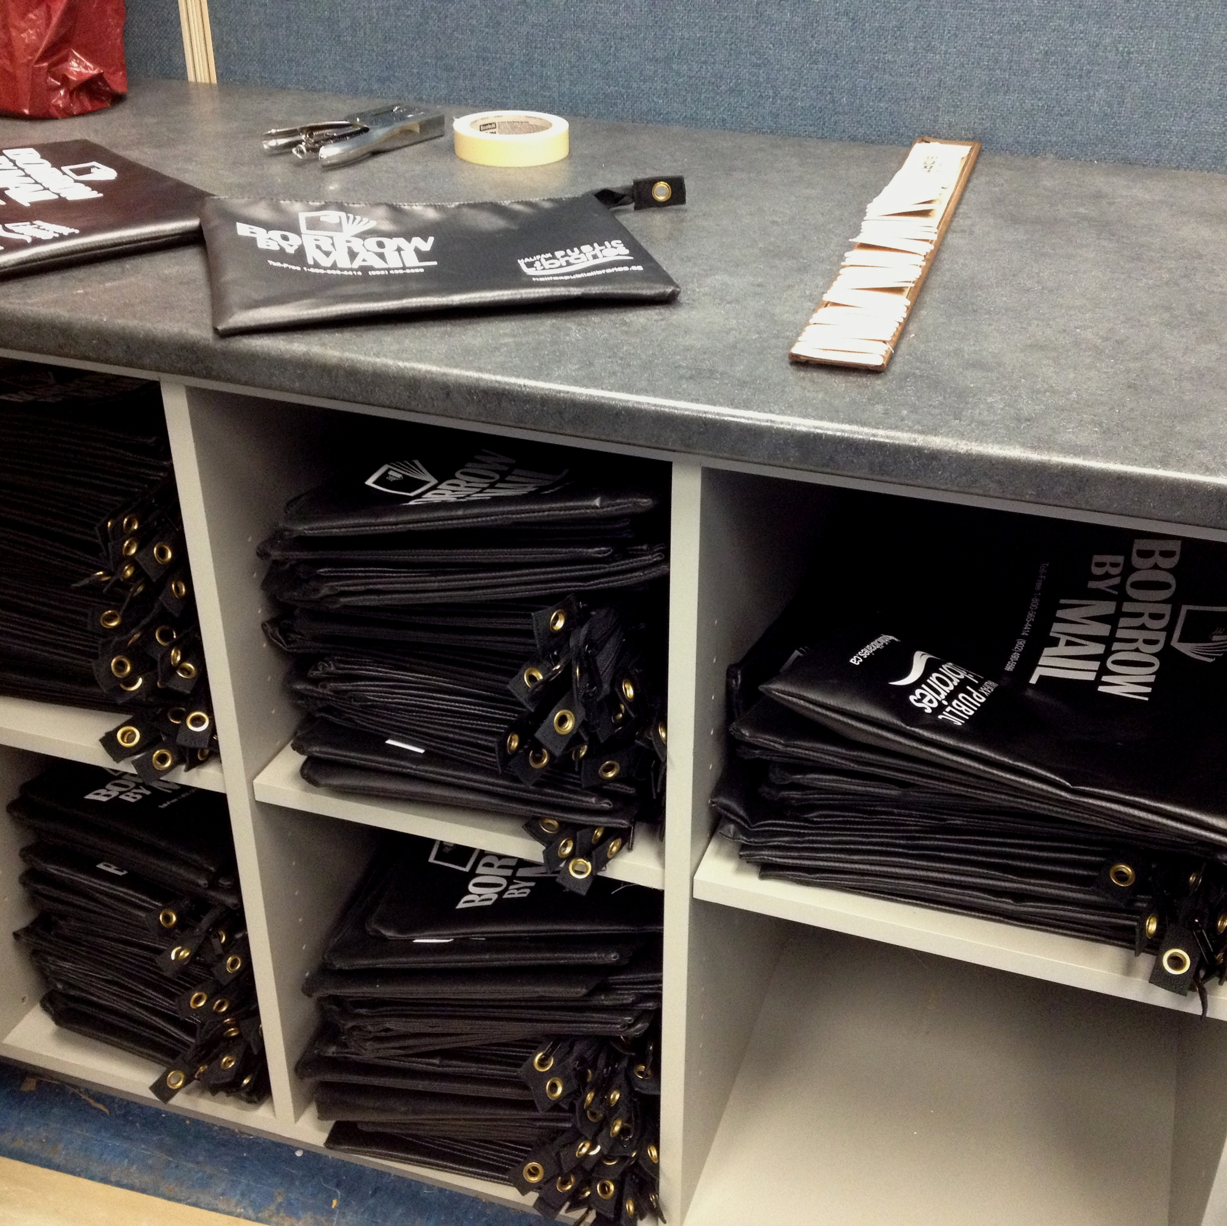

Slide 4
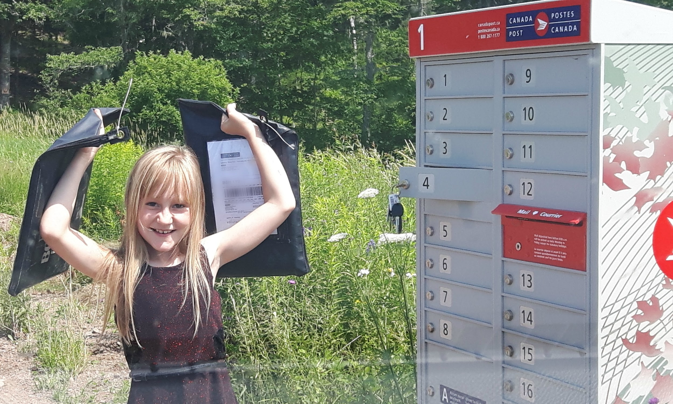
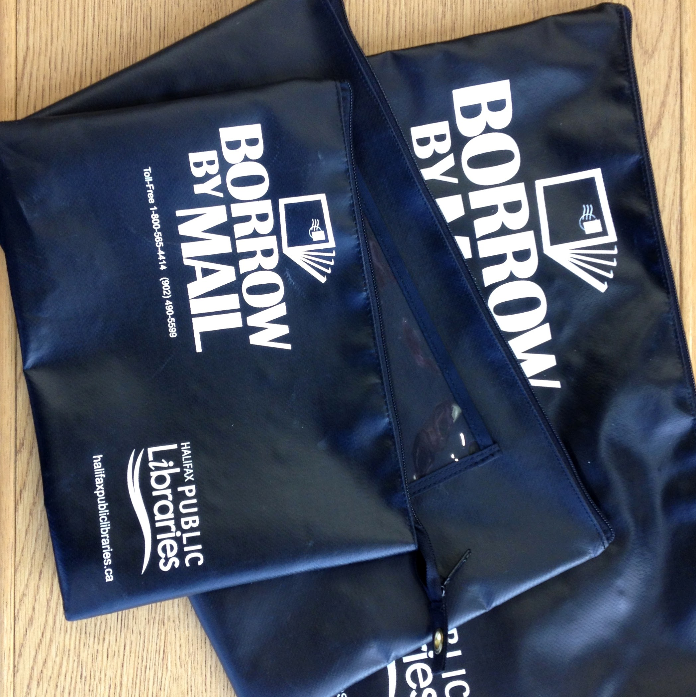

Slide 5



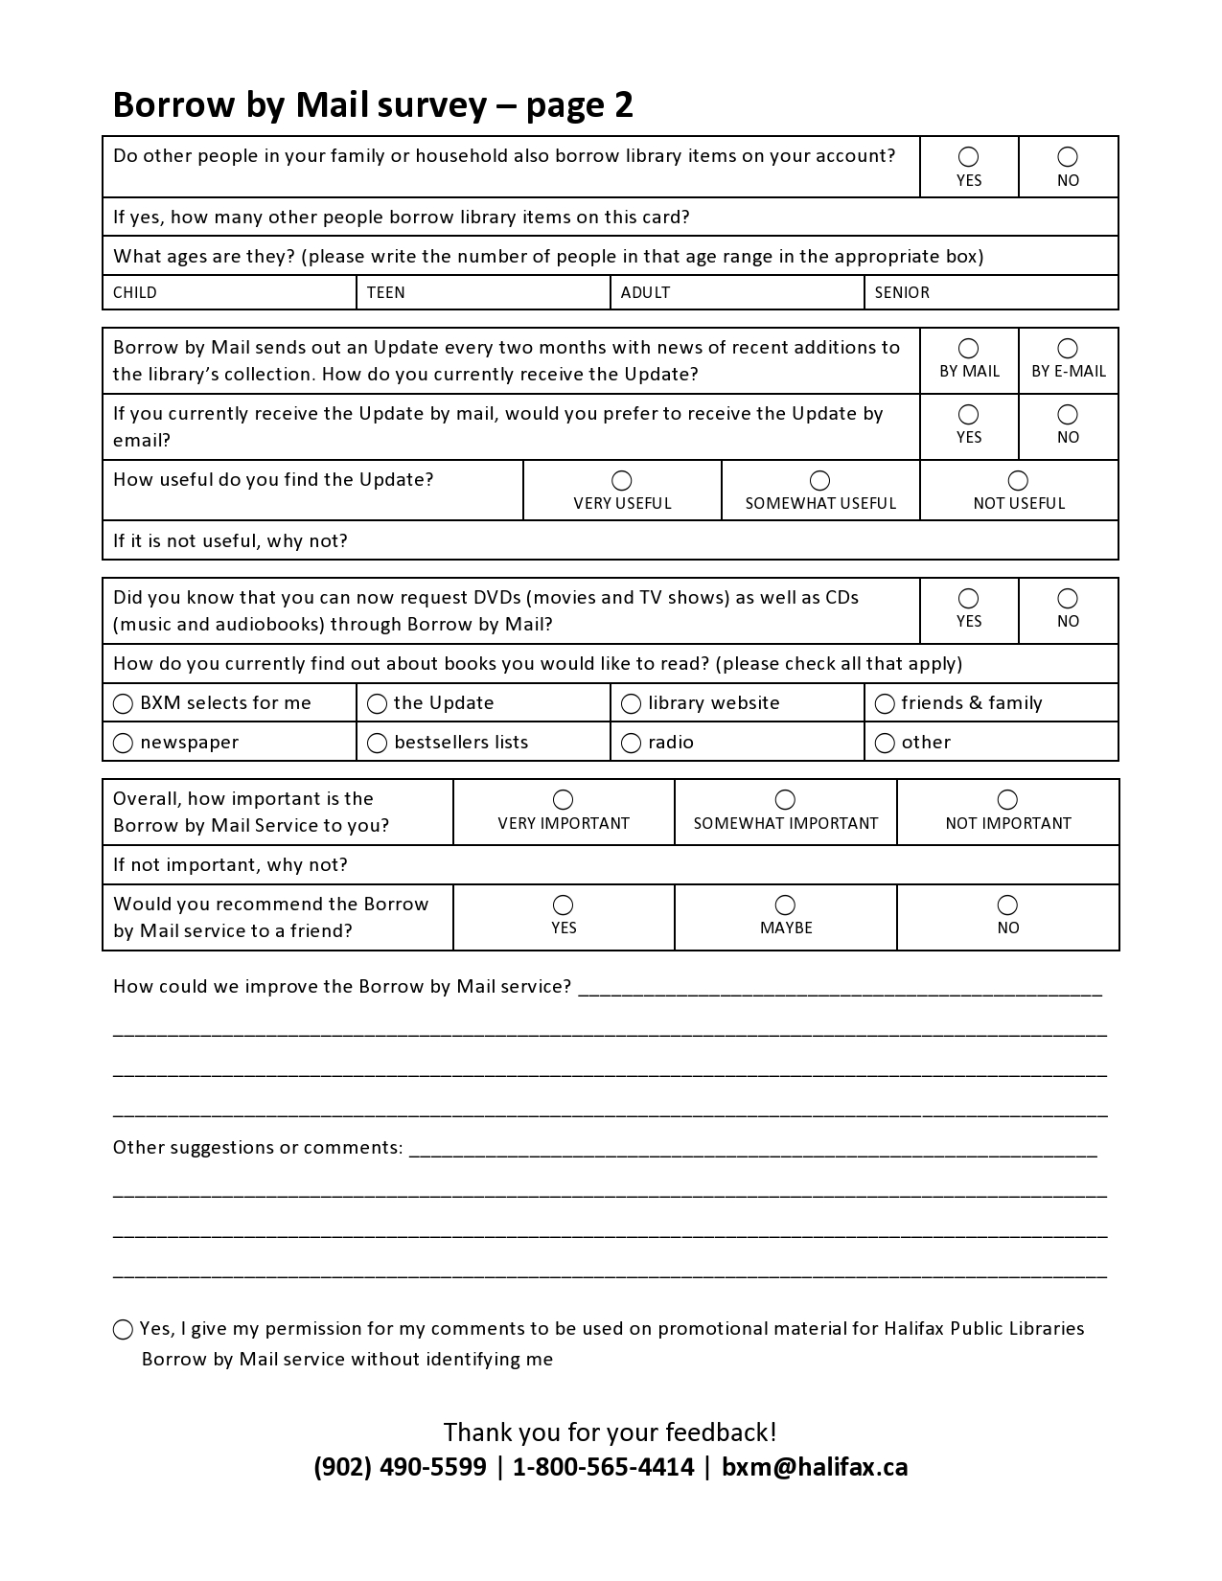

Slide 6
Borrow by Mail across Nova Scotia
 |  | # of clients 2015-16 | # of clients 2016-17 | circulation 2015-16 | circulation 2016-17
Annapolis Valley Regional Library | Borrow by Mail | 66 | 75 | 4266 | 4106
Cape Breton Regional Library | NA | - | - | - | -
Colchester East Hants Public Library | Books by Mail
Cumberland Public Libraries | Borrow by Mail | 76 | 62 | 1874 | 1664
Eastern Counties Regional Library | NA | - | - | - | -
Halifax Public Libraries | Borrow by Mail | 286 | 289 | 12 590 | 12 659
Pictou-Antigonish Regional Library | Books by Mail |  |  | 7993
South Shore Public Libraries | Borrow by Mail |  | 14 |  | 336
Western Counties Regional Library | Library Express | 178 - 230 | 158 - 173 | 1250 | 1093

Slide 7
Discussion Questions
How does a typical day look in your Borrow by Mail department? What is the workflow?
Do staff have other responsibilities with other departments?
How do you maximize available funds? What steps do you take to improve efficiency?
How did the switch to Canada Post’s Electronic Shipping Tool go?
Any issues with rural delivery? Drivers? Mailbox size? Community boxes?
How do your clients hear about the service? Do you take new clients?
Do you select for most of your clients? All? What are your favourite tools to help with selection?

Slide 8
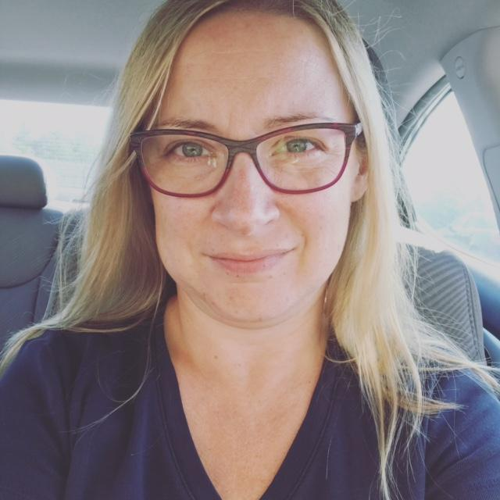
Keep in touch!
Maura Duncan
Supervisor, Borrow by Mail
Halifax Public Libraries
902-490-6731 | duncanm@halifax.ca
Amanda Fullerton
Manager, Eastern Shore & Musquodoboit Valley Library Services
Halifax Public Libraries
902-476-8608 | fullera@halifax.ca

Slide 9
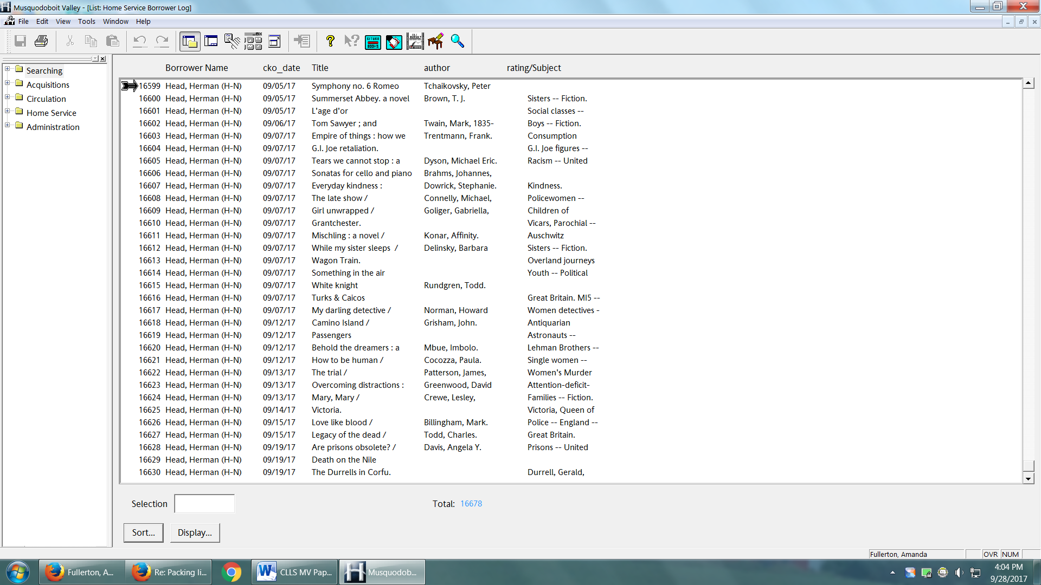

Slide 10
